Slide 1
Chapter Unit Elections Administration
Membership Committee
Amangamek-Wipit Lodge #470
National Capital Area Council #82

Slide 2
Objectives
Review national and lodge guidelines on eligibility and conducting elections
Provide an understanding of how chapter officers and advisers organize elections
Guide chapters through the unit and candidate communication process
Explain election reporting requirements

Slide 3
Agenda
Election Season Overview
Eligibility Requirements
Organizing your Team
Unit Communication
Reporting Elections
Call-out and Adult Nominations
LodgeMaster Inductions Live Demo

Slide 4
Elections Season
Elections Committee Chair & Adviser Appointment
Prior to elections season the chapter chief needs to appoint an scout to run elections. The chapter adviser will appoint an adult scouter to advise the elections committee.
Nov. 1st Announcement to units that elections season has begun and will end June 1st
The chapter may choose to mail a letter to the unit leaders. An email will be sent out through Lodge Master with a scheduling portal.
Chapter Elections Team training
The chapter elections committee will hold elections training and encourage its members to sign up to help conduct elections

Slide 5
Elections Season
Units will begin scheduling elections
The elections committee will review proposed dates the unit has submitted and confirm availability of their election teams.
Units will prepare for an Election
The unit will add eligible candidates to the online portal or submit a pre-election excel report to the committee
Chapter Elections Committee will prepare for an election
The committee will print out the election forms and ballots generated in Lodge Master and OA information pamphlets for the unit TOAR
Reminders will be sent to units once a month to schedule their election
Or the unit may prepare its own forms and ballots using the paper forms provided
The committee will confirm all supplies and members are available

Slide 6
Elections Season
Elections are Conducted
Election Teams will perform scheduled elections as outlined by the lodge and national guidelines
Elections are Reported
The Elections Committee chair and Adviser will submit election results in Lodge Master within a week of the completed election
Membership Committee Approves election report
The Lodge membership committee will review the submitted election results and unsure all data was collected
Teams will ensure that the unit and the chapter retain a copy of the election results and all candidate information is correct and future points of contact are identified for the unit
Teams will confirm when the unit will do their call-out
A call-out date will be set in the system
Once approved, a recap message will be sent to the unit to include a list of all elected candidates, induction opportunities and information on adult nominations
Teams will provide results promptly to the Elections Committee Chair

Slide 7
Elections Season
Adult Nominations Committee Formed
Units Submit Adult Nominations
Lodge Approval
The district selections committee will submit all selected candidates to the lodge nominations committee for processing.
The lodge committee will select all districts & council nominated adults
Announcements will be sent out to members through the lodge or chapter
The chapter advisers will form a committee with the district committee camping chair, district executive and any other appointed members
Units will nominate adult leaders into the OA based on the instructions received in their recap message.
The district selections committee selects adult candidates based on the national and lodge guidelines

Slide 8
Elections Season
Units alongside the chapter will announce youth and adult candidates
Elections Season Ends June 1st
All elections must be completed by July 1st. Adult nominations may be accepted up until June 30st
Inductions
Candidates will receive monthly notifications regarding scheduled inductions
Congratulations letters may be sent by chapters. An email will be sent to all candidates inviting them to sign up for their member portal and encourage ordeal registration
Those units who did not hold an election should be contacted by the chapter adviser and district executive
Call-Outs
Candidates have 1 year from their election to complete their ordeal

Slide 9
Youth Eligibility Requirements
Unit Leader Approval: The unit leader must certify his Scout spirit (i.e., his adherence to the Scout Oath and Law and active participation in unit activities). The unit leader must also certify that the nominee meets all specified requirements at the time of this annual election.
Be registered in the Scouts BSA and hold one of the following ranks corresponding to the type of unit in which they are being considered for election: Scouts BSA First Class, Venturing Discovery Award, or Sea Scout Ordinary, or higher.
Nights of Camping: 15 nights within the last two years, with 5 of them being associated with long-term camping. Camping approved and under the auspices and standards

Slide 10
Adult Eligibility Requirements
Nominated by Unit: The number of adults nominated can be no more than two-thirds of the number of youth candidates elected, rounded up where the number of youth is not a multiple of three. In addition to the two-third limit, the unit committee may nominate the currently serving unit leader (but not assistant leaders), as long as he or she has served as unit leader for at least the previous twelve months.
Registered Adult Leader: Be 21 Years old or older and a registered leader in the Scouts BSA
Camping Requirement: The camping requirements set forth for youth members are fulfilled
Be Selected: Each district shall form an adult selection committee of the District Scout Executive, Chapter Adviser, and District Vice Chairman for the Program to review and select the candidates for membership. The committee considers the following:
Ability to perform the necessary function to help the Order fulfill its purposes
The individual will be an asset to the Order
Be a positive role model

Slide 11
Adult Eligibility Requirements
Adult leaders in council and district positions: The lodge adviser, district chairman, council president, or members of the professional staff may nominate adults to the lodge adult selection committee. All requirements set forth for adult leaders in units must be fulfilled, with the exception of the camping requirements, which may be waived at the discretion of the Lodge Adviser and Scout Executive. The Lodge Adult Nominations Committee consists of the Lodge Adviser, Lodge Staff Adviser, and Council Camping Committee Chairman.
Final Approval: After selections at the district and lodge level, the Council Scout Executive must approve adult candidates in the Order of the Arrow. Adults may be nominated for membership only one time per year as either unit Scouters or district/council Scouters, but not both.
Submission: All adult nominations go to inductions@wipit470.org for processing

Slide 12
Organizing the Team
Elections Chair & Adviser
Appointed by the Chapter Chief and Adviser
Organizes election teams and schedules elections with units
Trains and ensures election teams are prepared for each election
Reports election results to the Chapter Chief and Lodge Membership Committee through Lodge Master

Slide 13
Organizing the Team
Basic Election Team Training:
Objectives: Know the rules and regulations, and be able to effectively run an election
Welcome & Introduction: Explain the purpose of the session and the importance of participating in unit elections
10 Minutes- Rules: Explain the election rules and procedures by utilizing the NCAC OA Unit Elections Guide. Review each rule and procedure
10 Minutes - Process: Review the Unit Elections Team Checklist and Unit Elections Ceremony Resources. Review examples of the pre-generated or handwritten paperwork. Review your chapter’s procedure in distributing the paperwork ahead of time
20 Minutes – Practice: Have the group go through each part of the performance
Consider utilizing the national elections guide or videos during your session
Chapters should consider offing elections training between November and February

Slide 14
Organizing the Team

Slide 15
Organizing the Team
Recruit team members well in advance and practice your chapter’s election presentation. Teams should know to stress the following points during an election:
Select the candidates who, in your opinion, have set the best examples of brotherhood, cheerfulness, and service.
Vote only for those you believe will continue in unselfish service to your unit
If you feel that no one is worthy, turn in a blank ballot.
If you are new in the unit and do not know the candidates well enough to vote wisely, you may abstain by not turning in a ballot at all; this will not affect the final result.
Youths eligible for election also vote, and they may vote for themselves if they feel they are worthy. No adults 21 or older may vote in the election.

Slide 16
Organizing the Team
Provide and review the following to your teams before the election
Unit Elections Team Checklist
NCAC OA Unit Elections Guide
Printed pre-filled ballots and forms or blank forms, ballots, and contact sheets
Information regarding the upcoming ordeals, chapter events, and OA opportunities.
Unit Representative Support Pack

Slide 17
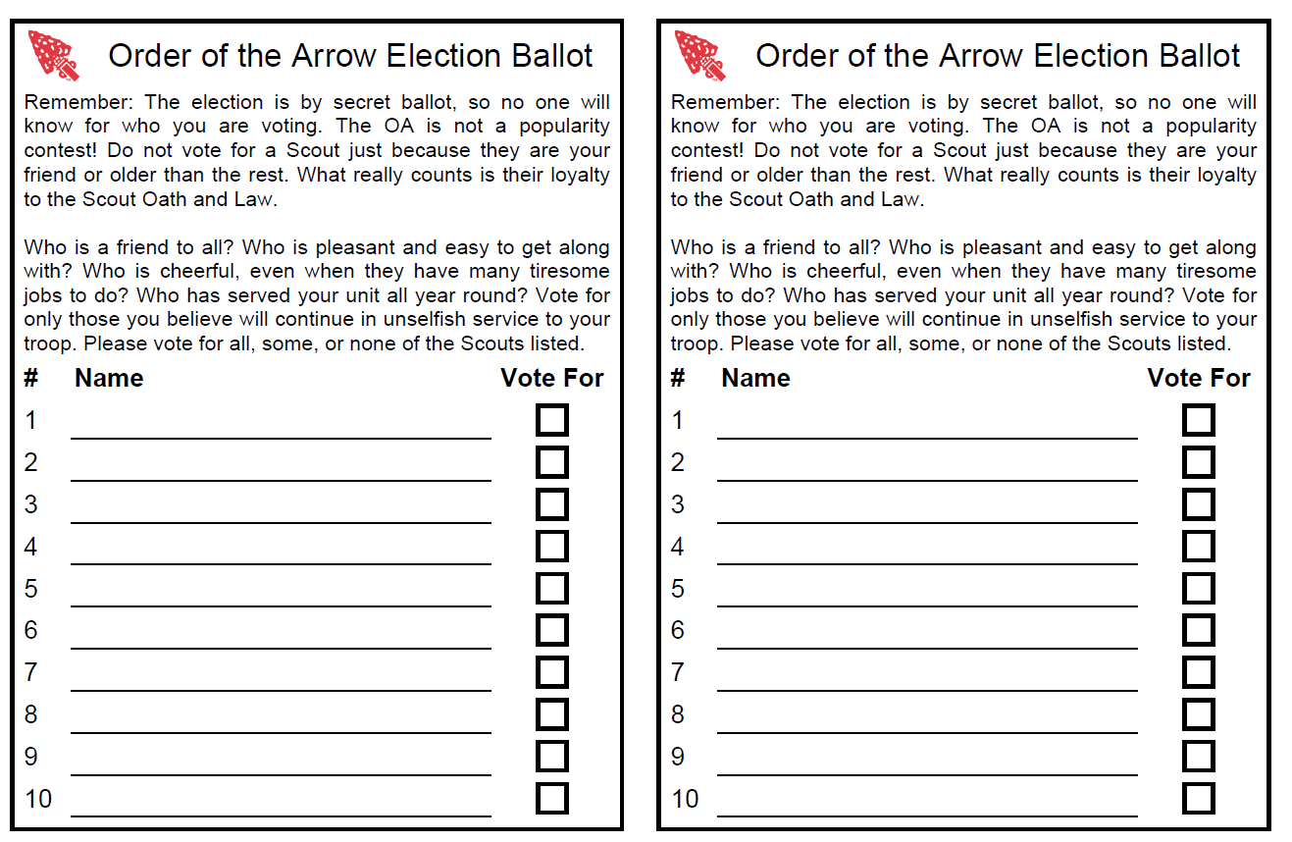
Organizing the Team

Slide 18
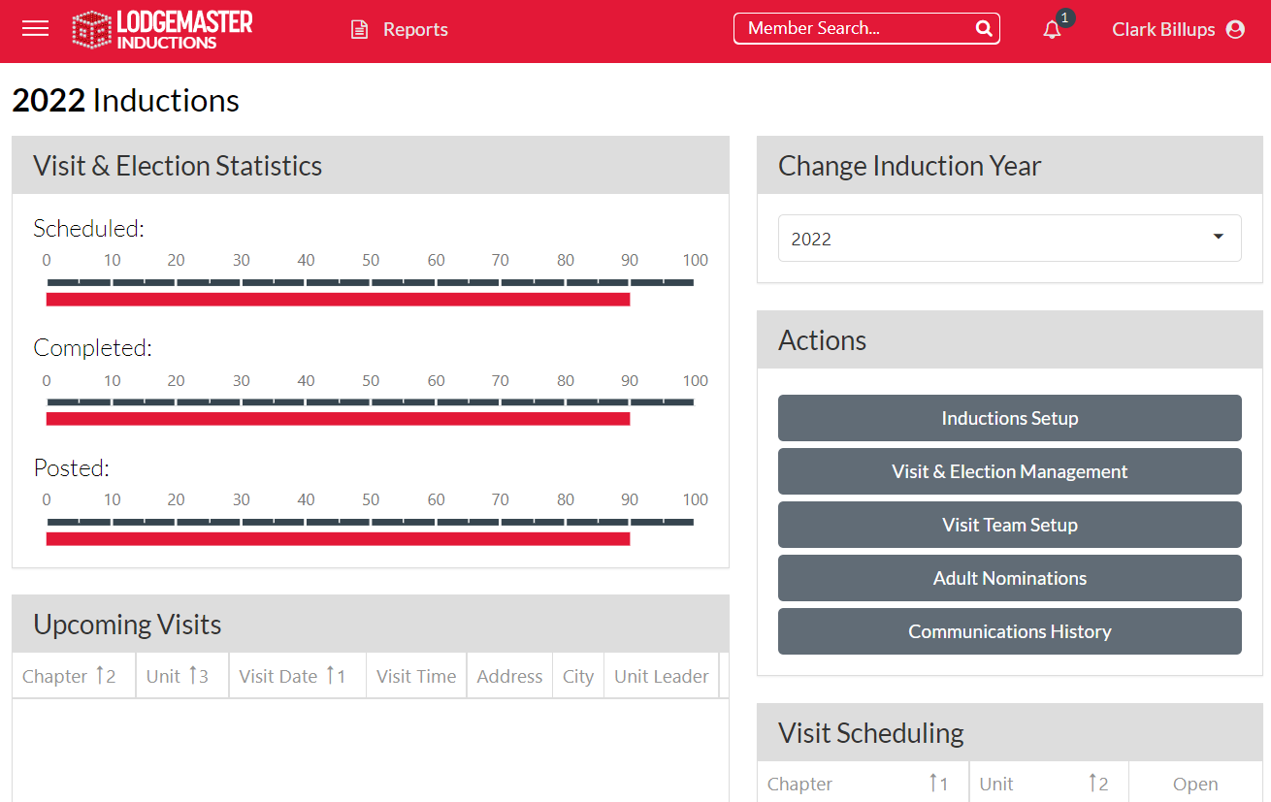
Organizing the Team

Slide 19
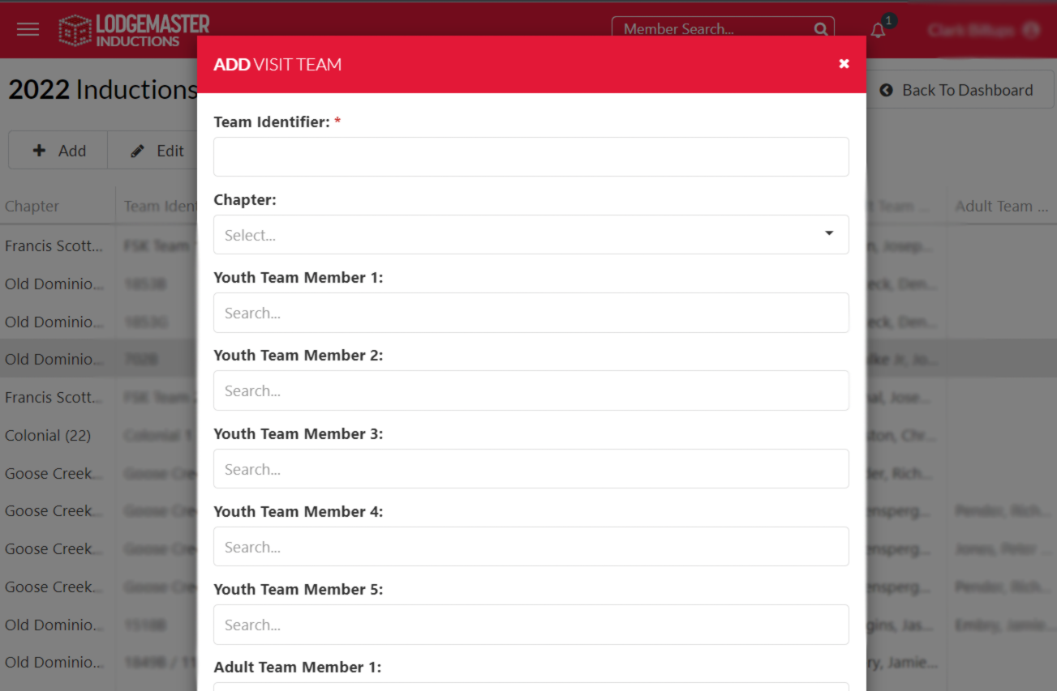
Organizing the Team

Slide 20
Unit Communication
Nov. 1st Request to Schedule Election
Monthly Reminder
Unit provides preferred dates
Unit Declines
Unit has no eligible youth

Slide 21
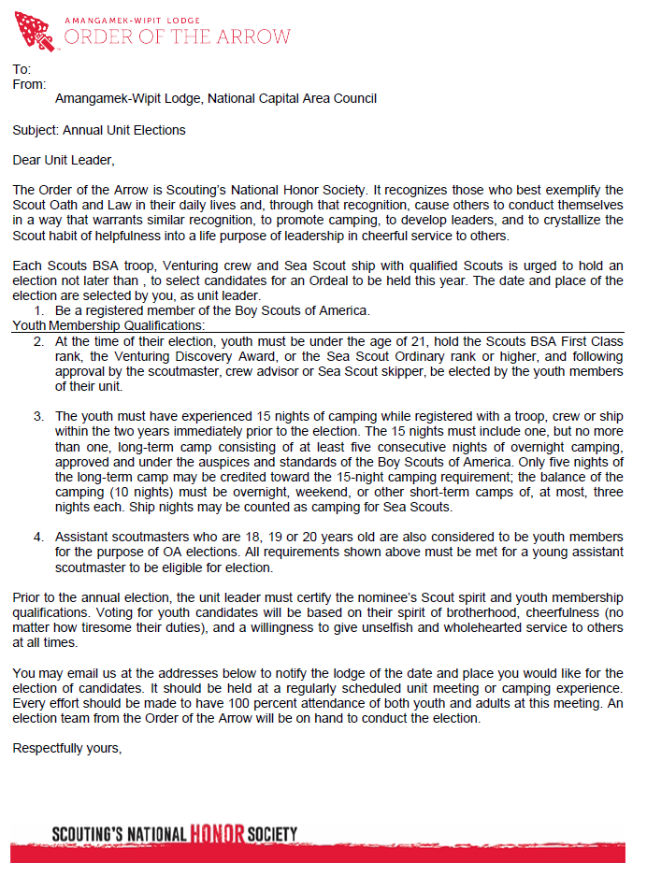
Unit Communication
Form letter that chapters may physically mail to unit leaders announcing election season in November.

Slide 22
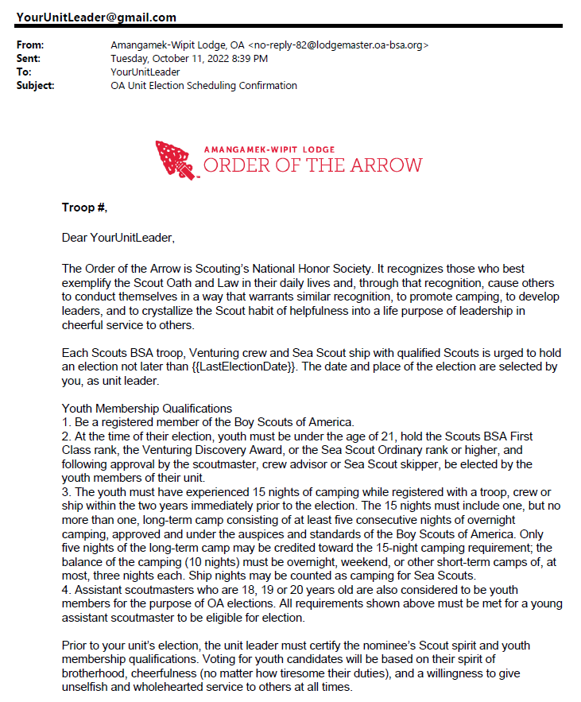
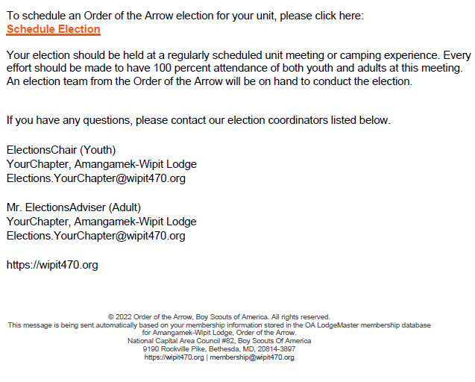
Unit Communication
Email sent to unit leaders automatically at the start of elections season on Nov 1st. Periodic reminders will be sent if the unit does not respond.

Slide 23
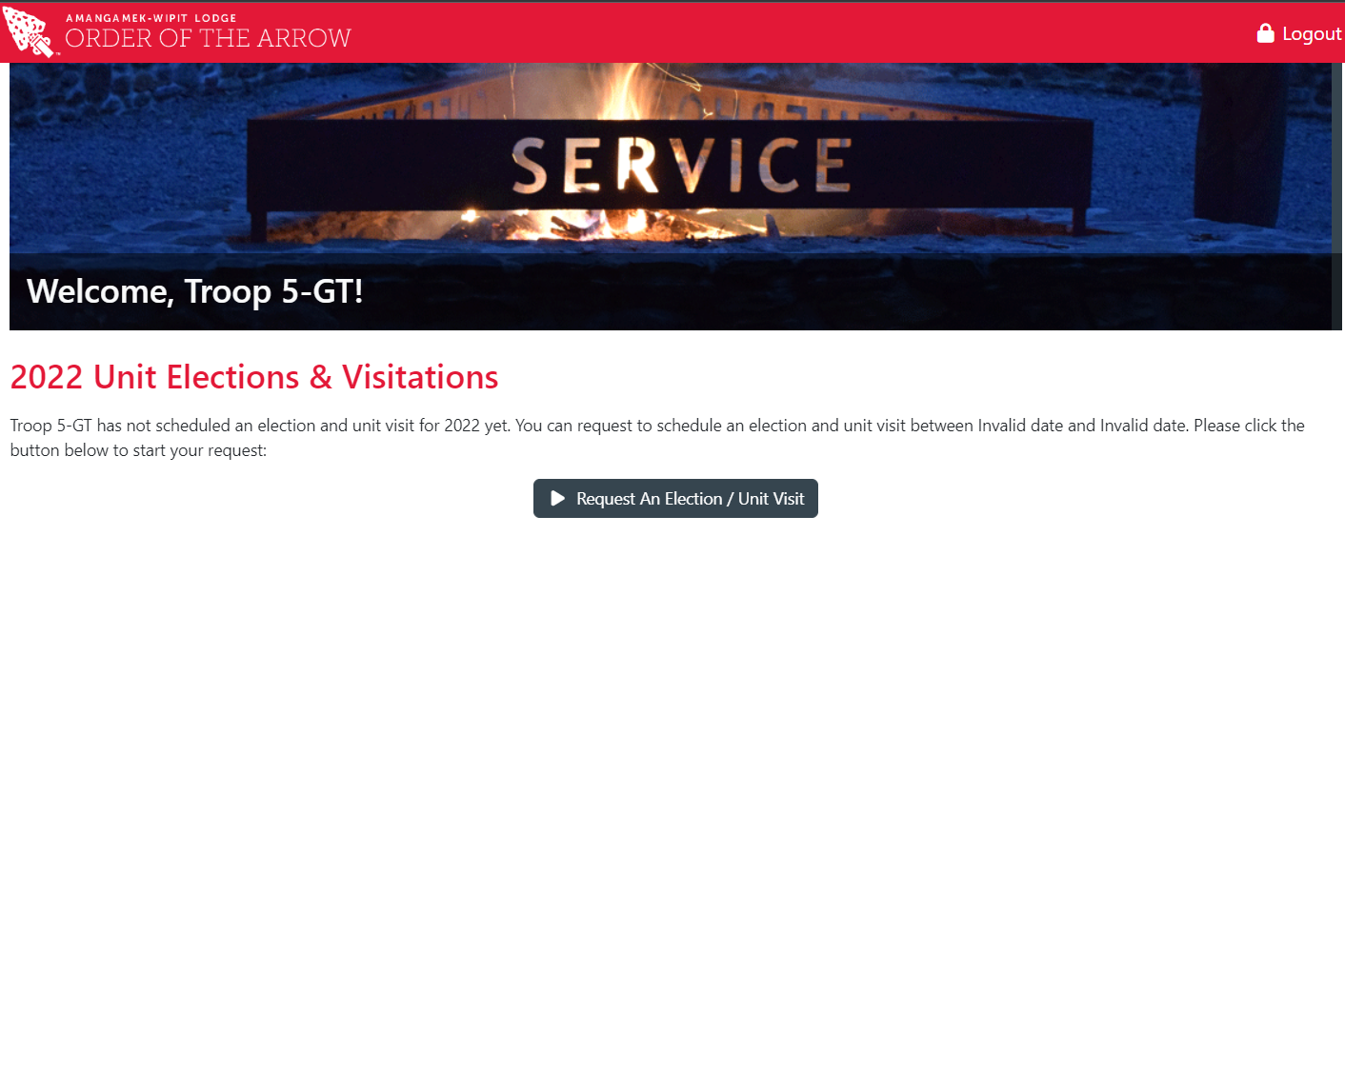
Unit Communication

Slide 24
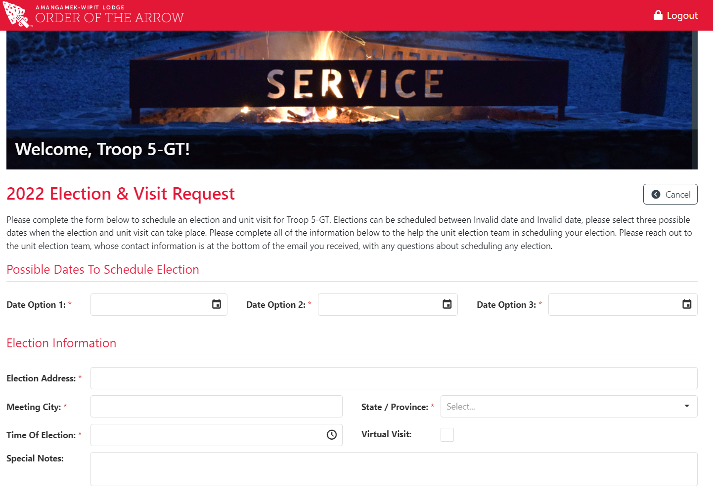
Unit Communication
Online unit scheduling portal provided in elections notification email

Slide 25
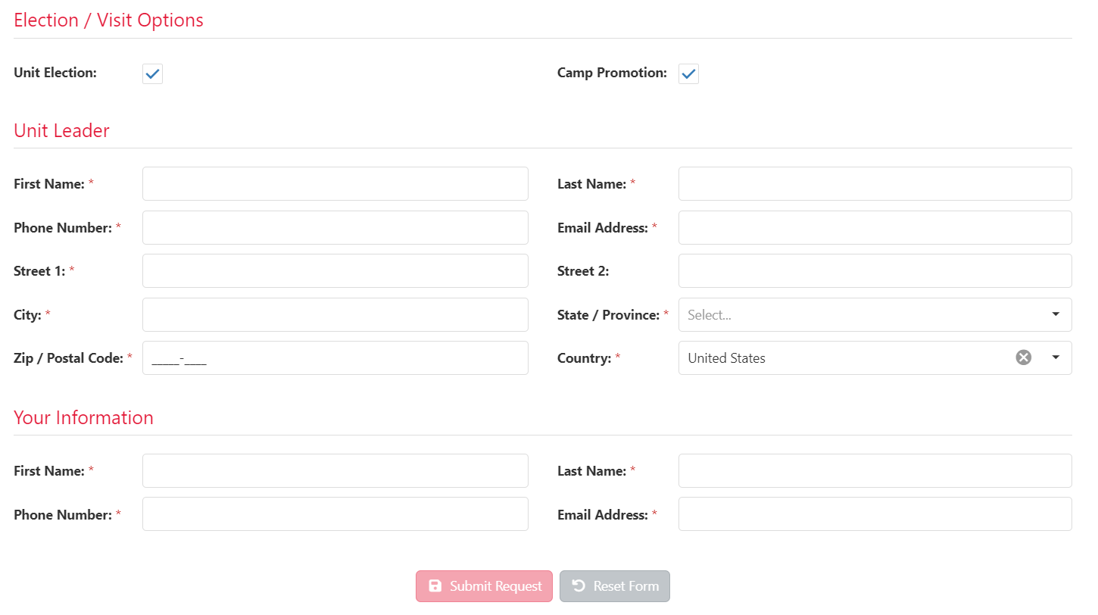
Unit Communication
Online unit scheduling portal provided in elections notification email

Slide 26
Unit Communication
Unit fills out online form
Elections Preparation Email & Request for Eligible Info
Committee Confirms Election Date & Time
Unit provides spreadsheet
Unit prepares paper forms
Elections Preparation Reminder

Slide 27
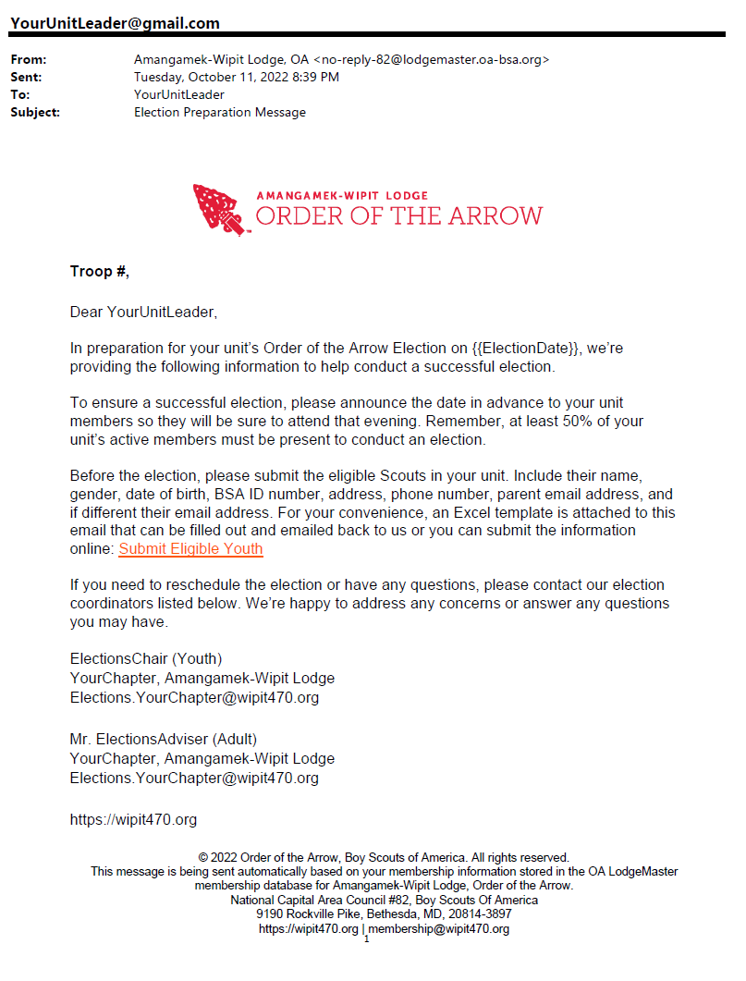
Unit Communication
Elections confirmation email providing portal for units to provide names of youth eligible. Units may opt to fill out a spreadsheet or do their election manually in a PDF fillable form.

Slide 28
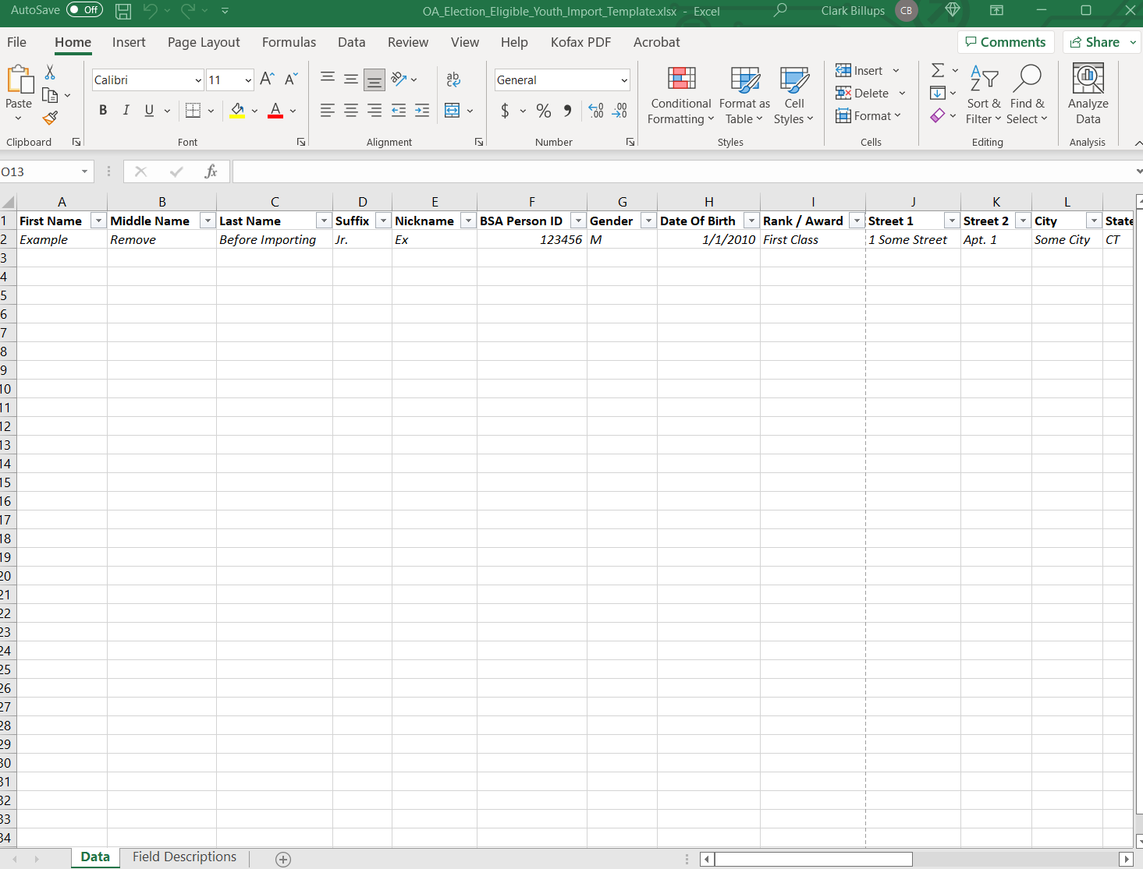
Unit Communication
Example of fillable form for units to provide prior to election so chapter can print ballots and forms

Slide 29
Unit Communication
Election Recap to Units & Adult Nomination Process
Unit Submits Nominations to District Selections Committee
Unit and Chapter work together to provide call out
Monthly Inductions Status Follow up

Slide 30
Unit Communication
Elections recap message sent only to the unit leader with candidate information and an explanation of the adult nomination process.
A congratulations message only goes out after the unit schedules its call-out.
Follow-up emails are sent monthly to unit leaders providing a status of their candidates through the inductions process

Slide 31
Reporting Elections
Data Integrity: All of our membership data is dependent on accurate candidate information provided by units
The unit leader is encouraged to submit a pre-election excel report to the elections committee in advance to the election or fill out the online form sent in a link prior to the election, or download and complete the Unit Election Form and Candidate Information.
The names of the eligible candidates for membership should match the name by which they are registered with the Scouts BSA
Unit Election Report Includes:
The chapter, district, and unit information
DATE
No. of Youth Present
Name, BSA ID, Gender, Rank of eligible youth, and their elected status
Unit Leader’s signature and OA Election Team member’s signatures
Two copies of the unit election report are generated. One for the unit and one for the chapter’s records

Slide 32
Reporting Elections
Candidate information form:
All information should be added in full
Confirm BSA ID, phone number, youth email, and parent emails are accurate
Elections must be reported in Lodgemaster within one week of completion

Slide 33
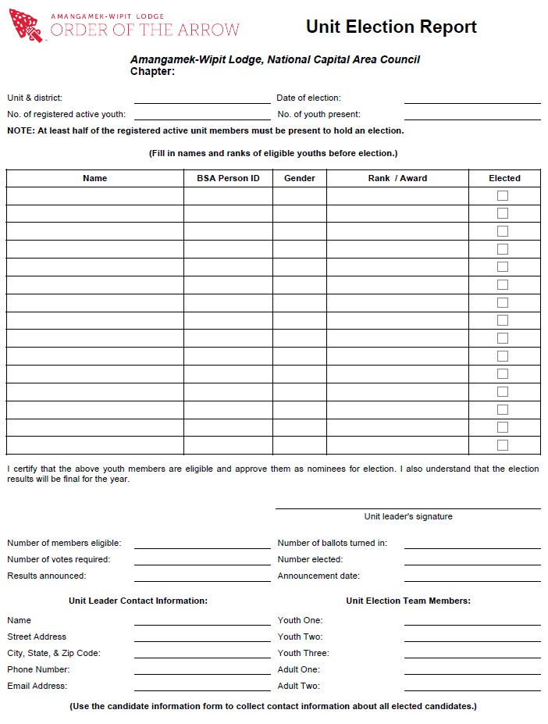
Reporting Elections
Pre-fillable elections report that can be printed off from lodge master with all unit, election team and eligible scout’s information

Slide 34
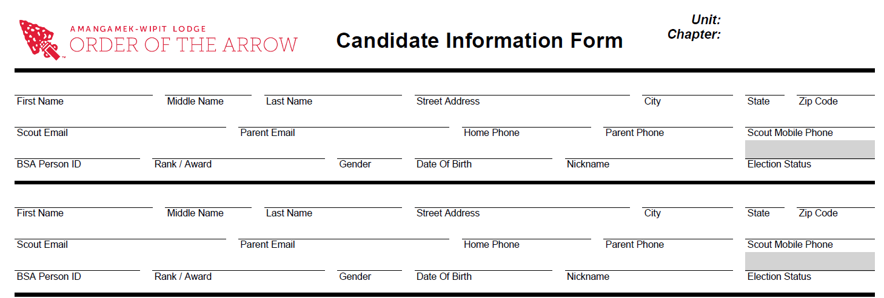
Reporting Elections
Pre-fillable info form that the elections committee will bring to elections to confirm contact details of those elected

Slide 35
Call Outs & Adult Nominations
The Unit Committee must submit all adult nominations by paper to the District Selections Committee. The point of contact will be the Chapter Adviser.
All committee-selected nominations must be sent to nonimations@wipit470.org to be processed.
After the unit-chosen callout date candidates and parents will receive a welcome message with instructions on signing up for the next ordeal

Slide 36
OALM Access and Sign-In
Acquiring Access and Signing In:
Fill out the privacy agreement, have the DE and Chapter Adviser Sign and submit to membership@wipit470.org
Create your OALM Amangamek-Wipit Lodge member portal in needed
Receive an invitation email and access Lodgemaster through the email
Input the unique code sent to you via email
Sign in for the first time by using your email as well as a personally created password
Access https://lodgemaster.oa-bsa.org/
Click “Lodge Client”
Try accessing Lodgemaster application on the homescreen
Input the same unique code sent to you via email
Test your access of “Inductions” on the left hand dropdown menu feature

Slide 37
Privacy Agreement & Disclosure
Overview: The Amangamek-Wipit Lodge of the Order of the Arrow, BSA, is committed to the
privacy of our members. Any information that is encountered while using the OA LodgeMaster
(OALM) program should be regarded with the highest security. The information contained within
this privacy agreement should be kept confidential should be utilized as you use the OALM
program.
Data: Data contained within the OALM databases is the property of the Amangamek-Wipit
Lodge , National Capital Area Council, Boy Scouts of America. This information may only be
used for official BSA or OA purposes. Information is not to be shared with anyone, unless
approved by the Lodge Key 3.
User Account Access: Members will be given access only to areas needed to complete their
specific duties. Only certain members outlined by the Key 3 will have the ability to edit
information, all others will have viewing privileges only. Only members of the Lodge Key 3 will
be able to create User Accounts and set account access levels.
Youth Protection: Those containing OALM user account access will be required to have the
following:
Adults should have completed Youth Protection Training.
Adults and Youth are required to attend a Key 3 Approved training for OALM
procedures.

Slide 38
Privacy Agreement & Disclosure
Privacy: Members providing their membership information for Lodge records did this with the
intent that the information will be used for OA/BSA purposes only. Under no circumstances
should any personal information be shared with anybody outside of the OA/BSA program or for
any purpose other than that of the OA/BSA. All data exports and reports should not be distributed
to anyone who is not currently registered as a Lodge Officer, Lodge Adviser, Chapter Officer, or
Chapter Adviser. Others requesting information should make the request though the Lodge Staff
Adviser and the Council.
Transmission of Data: Under no circumstances should personal information be e-mailed or
distributed without first taking security measures (i.e. encryption if necessary). Usernames and
passwords should never be distributed over e-mail but through other methods.
System: Users should use a secure computer with all security updates installed. Users need to
ensure that all anti-virus and firewall software are up to date and that any networks information
may be shared on are secure.
Security Measures: If you feel that your account information has been compromised, please
notify the Lodge Key 3 immediately so that your account can be blocked. If computer theft or
knowledge of a breach of computer security occurs the Key 3 should be notified as well.

Slide 39
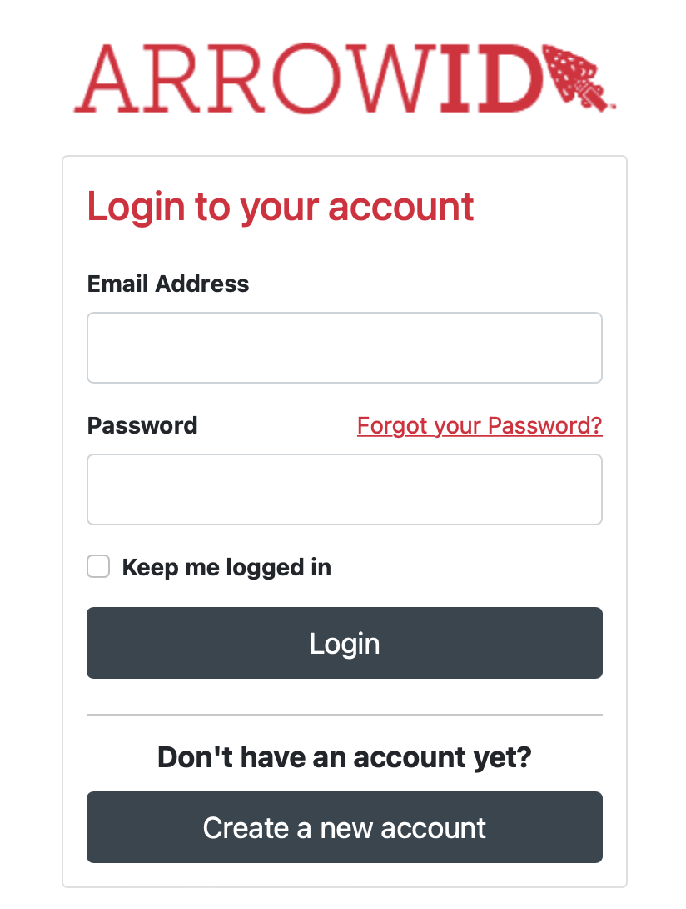
OALM Access and Sign-In

Slide 40
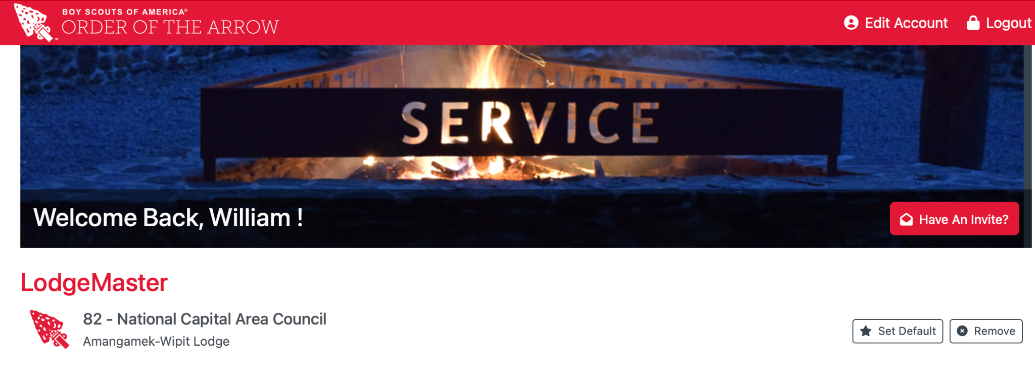
OALM Access and Sign-In

Slide 41
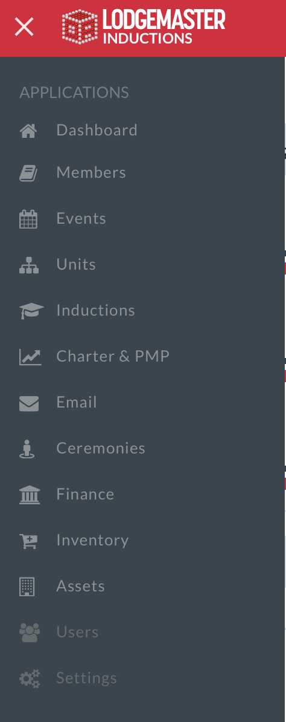
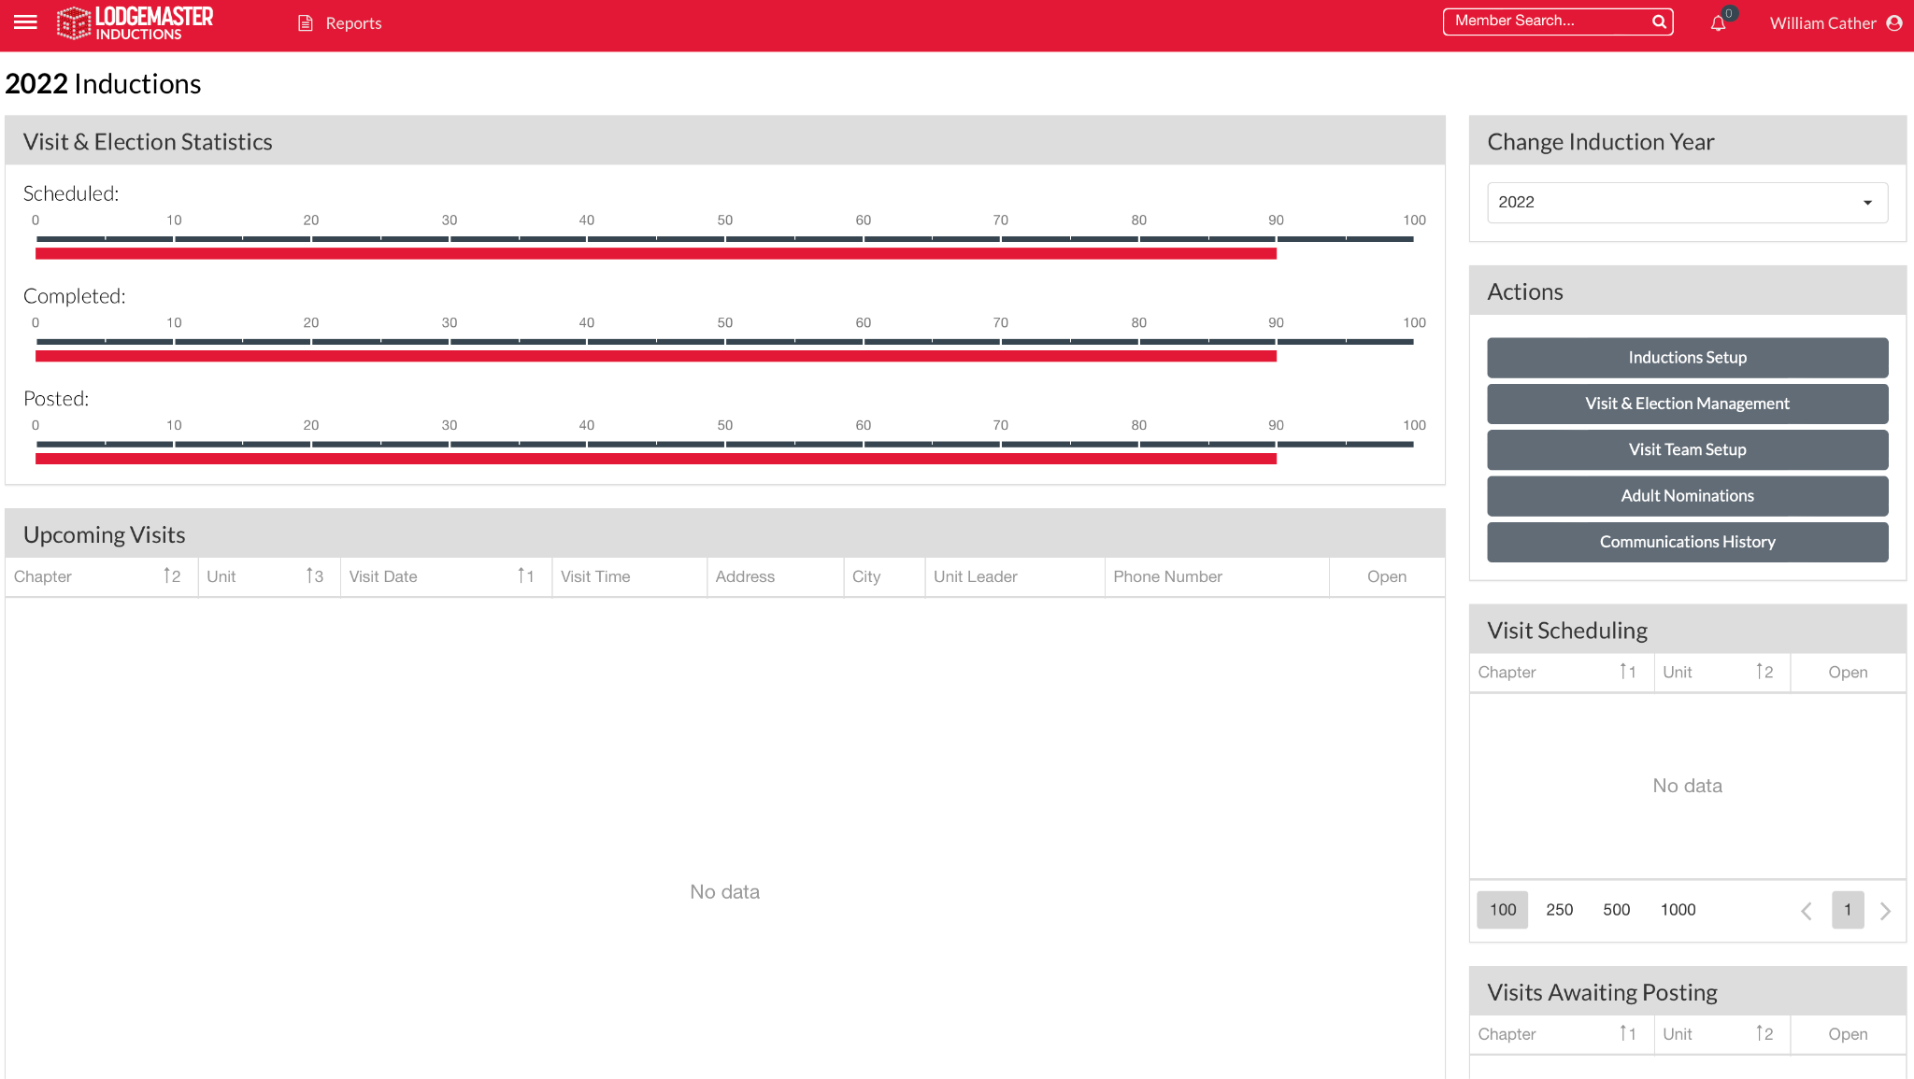
OALM Inductions
Homepage

Slide 42
Live Demo

